Slide 1


ZaranTech’s
www.zarantech.com
ZaranTech LLC. , http://www.zarantech.com, info@zarantech.com , (515) 309-7846

Slide 2
Business Senario:
Source System is :MS SQL SERVER 2008
Create a data store to “ SQL server “ by connection to “BODS” database.
Database server is : BODSSERVER
Datbasename is : BODS
Import the table functions_in
Source table :
functions_in
Zaran Tech LLC. , http://www.zarantech.com, info@zarantech.com , (515) 309-7846

Slide 3
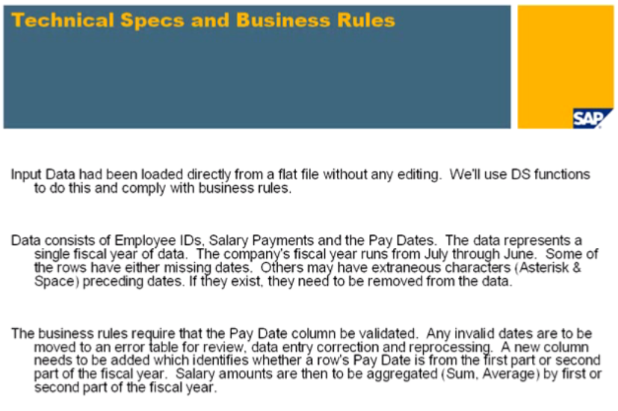
Zaran Tech LLC. , http://www.zarantech.com, info@zarantech.com , (515) 309-7846

Slide 4
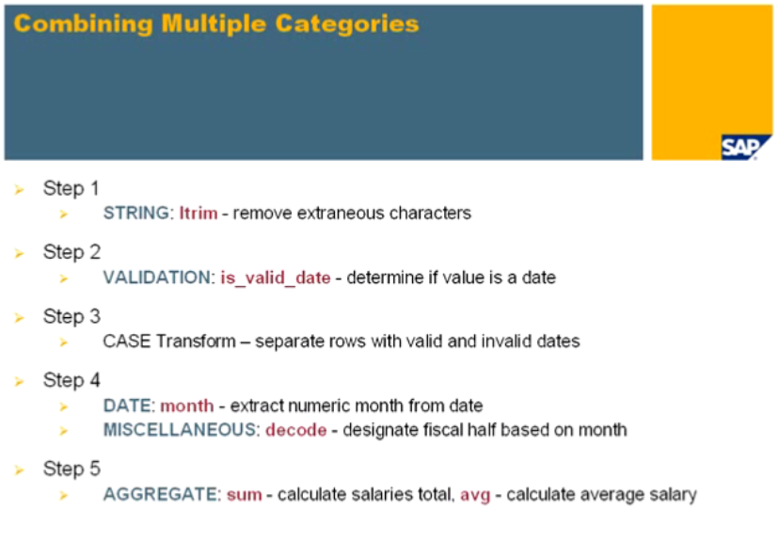
Zaran Tech LLC. , http://www.zarantech.com, info@zarantech.com , (515) 309-7846

Slide 5
Zaran Tech LLC. , http://www.zarantech.com, info@zarantech.com , (515) 309-7846

Slide 6
Thank You !
www.zarantech.com
ZaranTech LLC. , http://www.zarantech.com, info@zarantech.com , (515) 309-7846

